Slide 1
Early Modern Photography
By: Anne Jeanine Delgado
Last updated: 10 December 2016

Slide 2
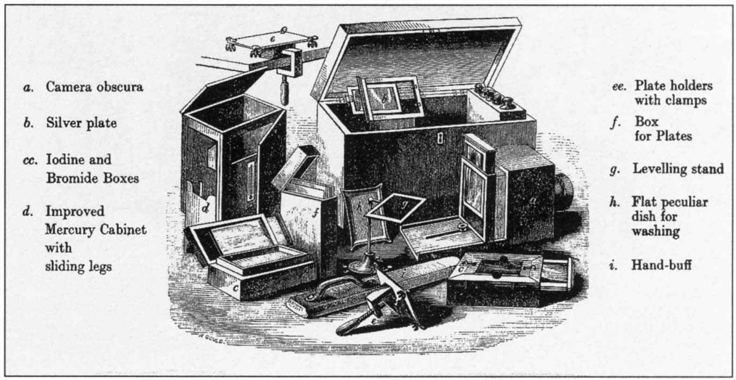
History
1490 Camera Obscura
First photograph created in 1826 using heliography by Joseph Nicephore Niepce
Louis Dagurre invented the first commercially successful photographic process called the Dagurreotype
Notes:
We can begin our understanding of photography with the camera obscura which was developed in 1490.
The first photograph as we understand the concept today was created in 1827 by Joseph Niepce.
The first photographic process that was commercially successful was developed by Louis Dagurre.
These concept is developed in more detail in the next slide.
http://www.photohistory-sussex.co.uk/DAGapparatus.jpg

Slide 3
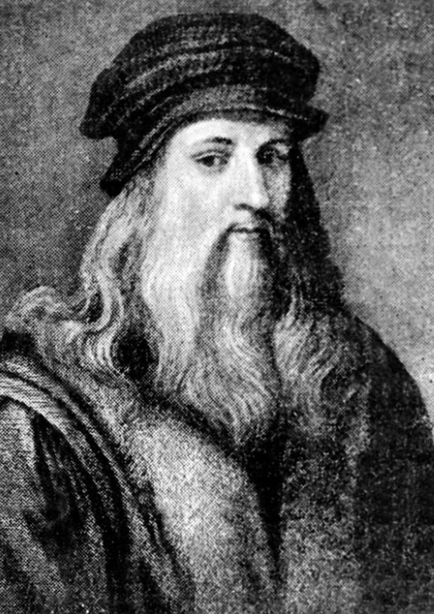
History
Notes:
Click on image to play video.
https://youtu.be/JoxGEymA8ro
http://i2.mirror.co.uk/incoming/article6515551.ece/ALTERNATES/s615b/Leonardo-Da-Vinci.jpg

Slide 4
Photography Bias
Altering of a subject’s image in order to create a certain perception of that subject.

Slide 5
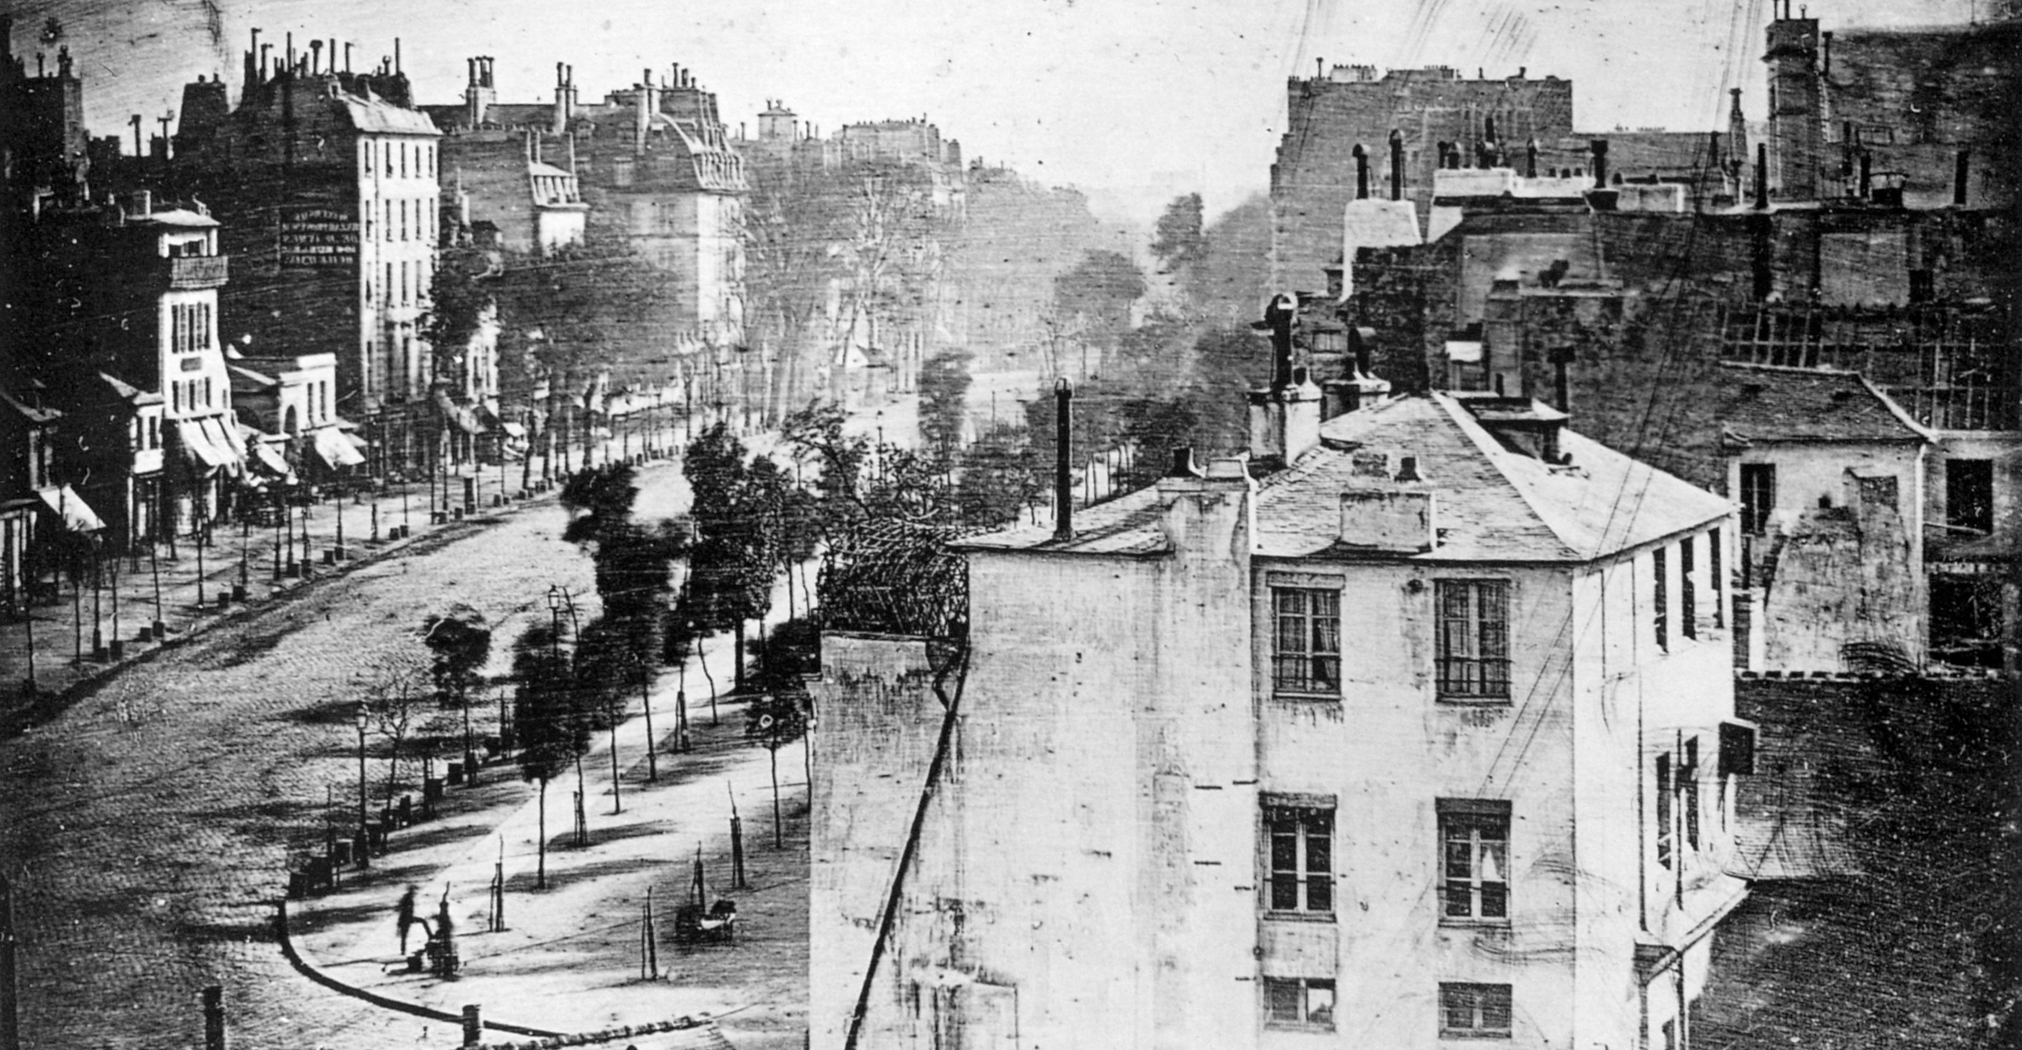
First Photograph
Of Person
Notes:
This is the first photograph of a person. It was taken in 1838 by Louis Daguerre. It shows a man having his shoes shined.
The photograph appears to be of an empty Paris street, but the street is actually bustling with people. The problem is that the moving people could not be captured in the image because of the slow shutter speed. Therefore, the street appears to be empty even though it is not.
https://upload.wikimedia.org/wikipedia/commons/d/d3/Boulevard_du_Temple_by_Daguerre.jpg

Slide 6
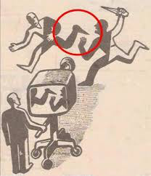
Notes:
Ask students to describe what they see in this image.
Then show the next slide.

Slide 8
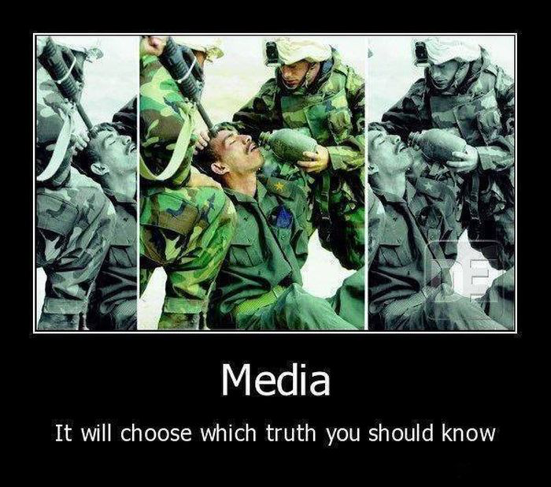
Notes:
Ask students to describe what they see in this image.

Slide 9
Notes:
Next, ask students to describe what they see in this image.

Slide 10
Notes:
Here is the original image that was cropped.
http://piximus.net/media/30849/how-the-media-manipulates-everything-1.jpg

Slide 11

Notes:
This is the meme from which the previous examples was taken.

Slide 12
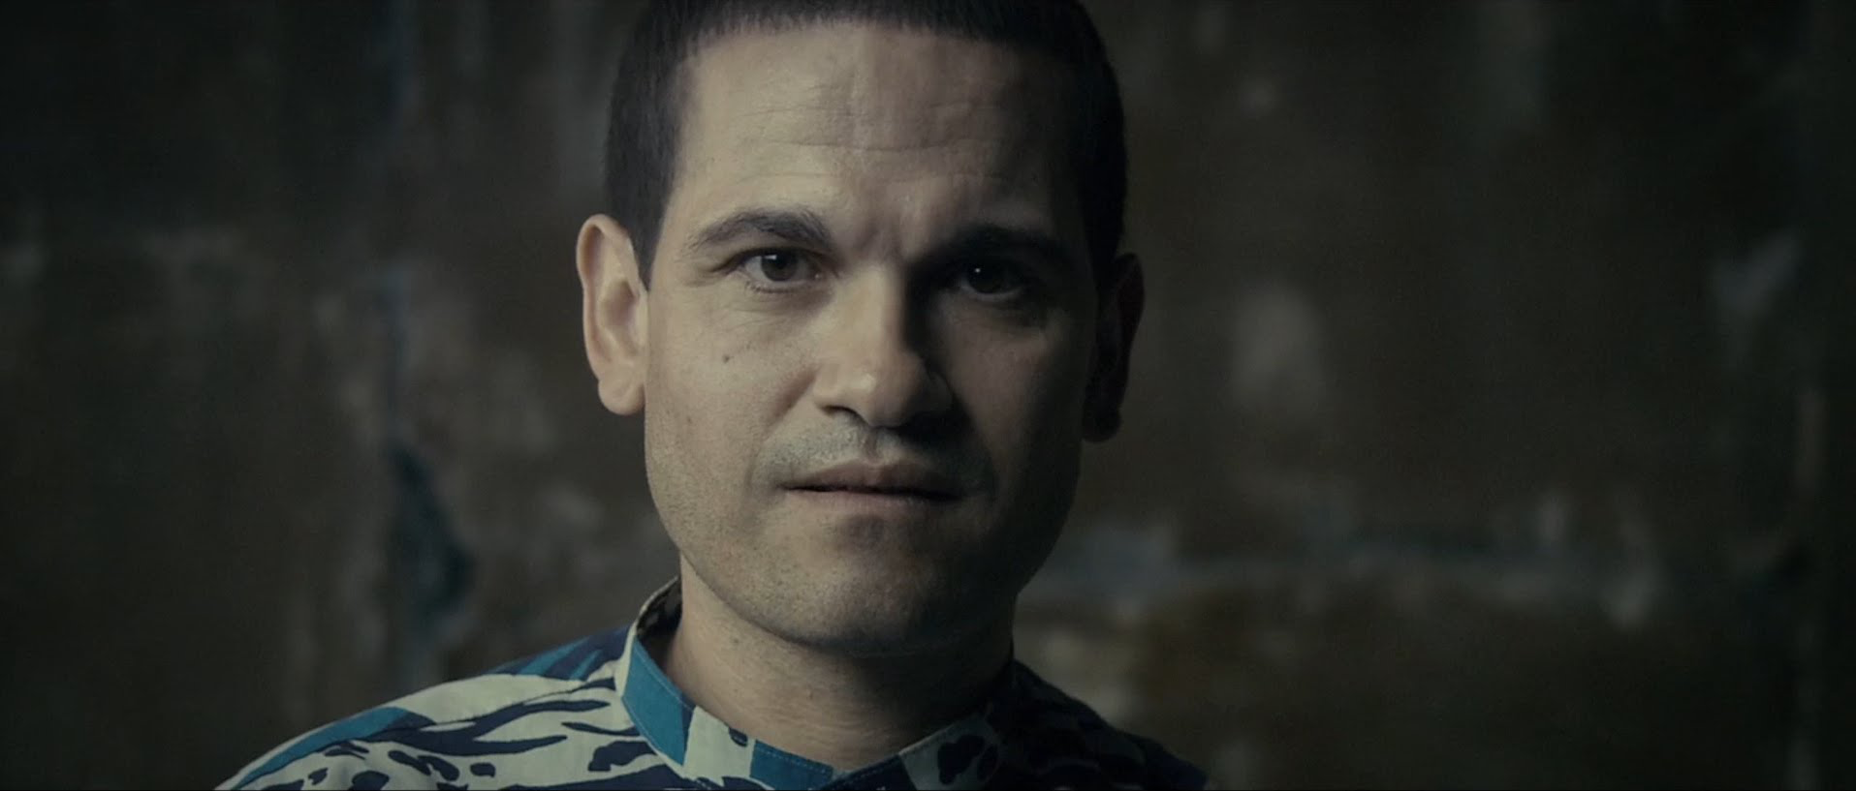
The Camera’s Tricks
Notes:
Click on image to play video: https://www.youtube.com/watch?v=Y0TnU80idDA
This 5:05 minute analysis of The Imposter (2012) explains how the film manipulates the audience to believe what they are predisposed to want to believe.

Slide 13
Do Pictures show the whole truth?
Notes:
Discussion question to end presentation.

Slide 14
Works Cited
Brennen, Bonnie, and Hanno Hardt. Picturing the Past: Media, History, and Photography. Urbana: U of Illinois, 1999. Google Books. Web. 26 Sept. 2016.
Brothers, Caroline. War and Photography: A Cultural History. London: Routledge, 1997. Google Books. Web. 26 Sept. 2016.
Camera: A History of Photography from Daguerreotype to Digital by Todd Gustavson. Dir. George Eastman House. YouTube. YouTube, 28 Sept. 2010. Web. 26 Sept. 2016.
Capelle, Romain. "Le Biais Racial De La Photographie Couleur." - Arts Et Scènes. N.p., n.d. Web. 25 Oct. 2016.
Concord, Stephen. "The Motion-Picture Emerging as Art." The Lotus Magazine 10.4 (1919): 204-07. Web.
Every Frame A Painting. "Chuck Jones - The Evolution of an Artist." YouTube. YouTube, 16 July 2015. Web. 26 Sept. 2016.
Gunning, T. "In Your Face: Physiognomy, Photography, and the Gnostic Mission of Early Film." Modernism/modernity, vol. 4 no. 1, 1997, pp. 1-29. Project MUSE.
Edwards, Steve. Photography: A Very Short Introduction. Oxford: Oxford UP, 206. Print.
Hartmann, Sadakichi. "Æsthetic Activity in Photography." Brush and Pencil 14.1 (1904): 24-53. Web.
"L'invention De La Photographie (1839)." L'invention De La Photographie (1839). N.p., n.d. Web. 25 Oct. 2016.
Marien, Mary Warner. Photography: A Cultural History. London: Laurence King, 2002. Google Books. Web.
Maxwell, Everett C. "Art In Photography." Fine Arts Journal 22.4 (1910): 179-82. Web.
"Modern Photography." Science 14.347 (1889): 218-21. Web.
Photography History & Techniques : Famous American Photographers. Dir. EHowArtsAndCrafts. YouTube. YouTube, 30 Mar. 2010. Web. 26 Sept. 2016.
Sprague, Stephen F. "Yoruba Photography: How The Yoruba See Themselves." Yoruba Photography (n.d.): n. pag. Web. 26 Sept. 2016.
The History of Photography in 5 Minutes. Dir. The Cooph. YouTube. YouTube, 08 Feb. 2016. Web. 26 Sept. 2016.
The Imposter (2012) – Looking Into The Lens. Dir. Every Frame A Painting. Youtube. Youtube, 25 Apr. 2014. Web. 26 Sept. 2016.
Van Muyden, G. "Recent Improvements in Photography." The Connoisseur 3.1 (1888): 28-34. Web.
"『「写真描写問題」を解いてみる』." TOEIC SWと、BULATSと、時々脱力系。. N.p., n.d. Web. 25 Oct. 2016.

Slide 15
Note about Creative Commons License
The Creative Commons license under which this presentation is being released does not apply to the individual images within the presentation. The images are used in the presentation under the Fair Use provision of copyright law and remain copyrighted by their authors. However, because of their age, the images in slide 02, slide 03, and slide 05 are in the public domain.

